Slide 1

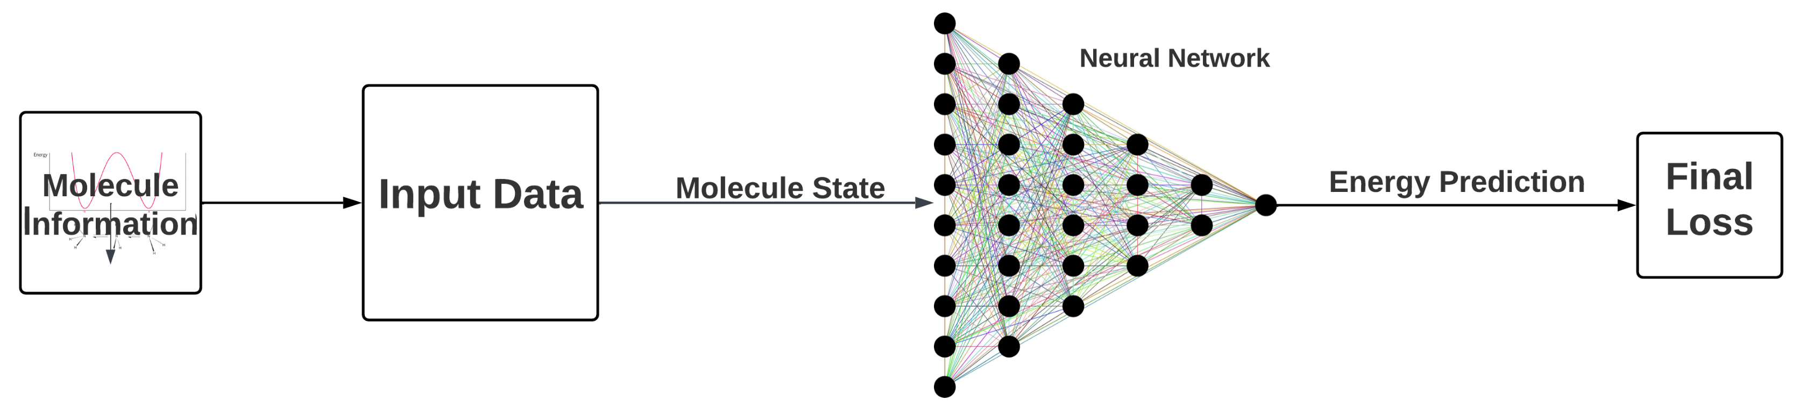
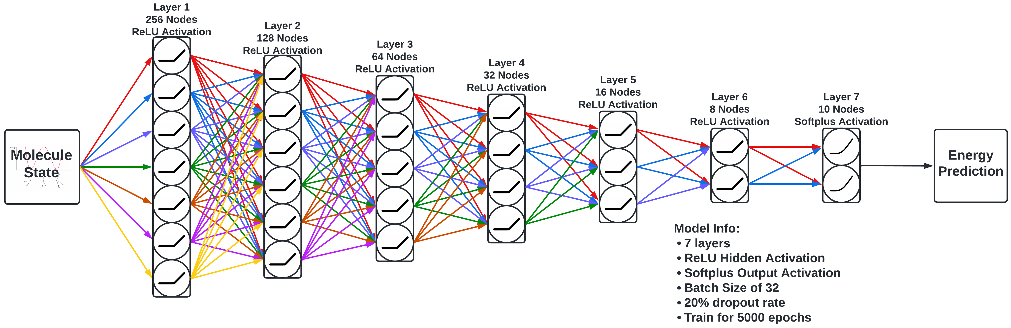
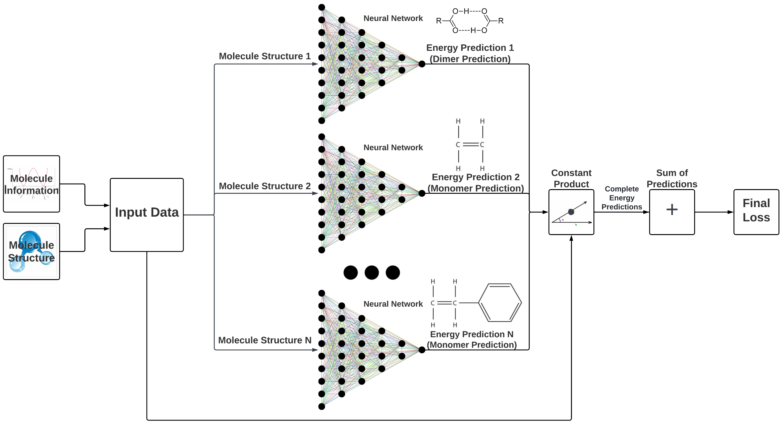
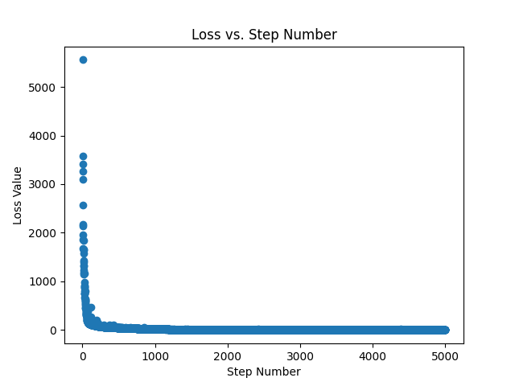




Neural Network Applications on Tensor Hypercontraction
Ishna Satyarth, Gabriel Mongaras, Dr. Devin Matthews
Southern Methodist University, Chemistry Department
Abstract
Methodology
Results
In this project, we aim to predict the MP3 (Third-Order
Møller–Plesset) energy of a molecule given information
on a state of a particular molecule. MP3 energy is used to
incorporate the electron correlation effects into
electron structure calculations.
MP3 energy is usually calculated using O(N⁶) operations
where N is the number of one-electron functions
which are used to predict the electronic wavefunction.
This operation is very computationally expensive
and takes a while to compute. While this method
Takes a while to compute, it is often very accurate.
While the usual method of predicting the MP3 energy of
a molecule is a computationally heavy process, other
methods have been produced which often take less
time to make a prediction, but usually result in a less
accurate prediction.
To bridge the gap between high efficiency but low
accuracy and low efficiency but high accuracy, our
model is composed of a neural network. After training,
the model will be able to produce a high accuracy
prediction while taking O(1)+O(N⁴) operations. The O(1)
operations comes from the neural network while the O(N⁴)
operations comes from the tensor hypercontraction of the
MP3 energy.
Our approach is to train a neural network which takes in a state of
a molecule and outputs the energy of that molecule in that specific state.
Model 1:
Out initial method uses a neural network which looks like the following:
This model takes in information on a molecule and its state and outputted
the expected MP3 energy.
To evaluate the model, we measure how close the predicted MP3 value
was to the actual MP3 value.
Model 2:
Our second attempt at solving this problem used a more complicated
model with the following structure:
This model not only took in the molecule information, but also took in the
molecule structure. Additionally, instead of only predicting the energy
for a single molecule state, the model predicts the MP3 energy for all
structures for a given molecule. For example, a water-ammonia molecule
has 10 states in our dataset. The first prediction is a dimer molecule
while each succeeding predicting is a monomer prediction.
To evaluate the model, we sum up all predictions and compare that against
the sum of the actual energies.
Model 1:
Loss defines how good our model did. The loss is an arbitrary value, but since the model evaluation between the models are the same, we can see which model does better. A lower loss means a model did better than another.
Looking at the loss values, we want to find the model with the lowest difference between the train and test loss while also having a low train and test loss. The following model has the lowest of these values:
The models ended with a mean train loss of 0.60495, a mean test loss of
0.49158 and a total mean train-test loss of 1.39390 given by the following
formula: (train loss * test loss) + train loss + test loss
This model had the lowest combined loss out of all tested model variations
More results of the model can be found using the following QR code:
Acknowledgements
Loss plot during training
Model 2:
The second model which uses the extra molecule structure data resulted in a loss
of 0.00083 using only 120 training epochs. Clearly this model shows better results than
the previous without being optimized. So, after optimizing this model, it will be able
to make better predictions than the first model. Using this new model, we plan to
make more accurate predictions.

